Slide 1

Final Project
Big Data Case Study in Social Media
Del Pino Ruiz, Vicente Rubén
csci e63 Big Data Analytics, 2014
Harvard Extension School
Professor: Zoran B. Djordjević
@Vicente Rubén Del Pino Ruiz

Slide 2
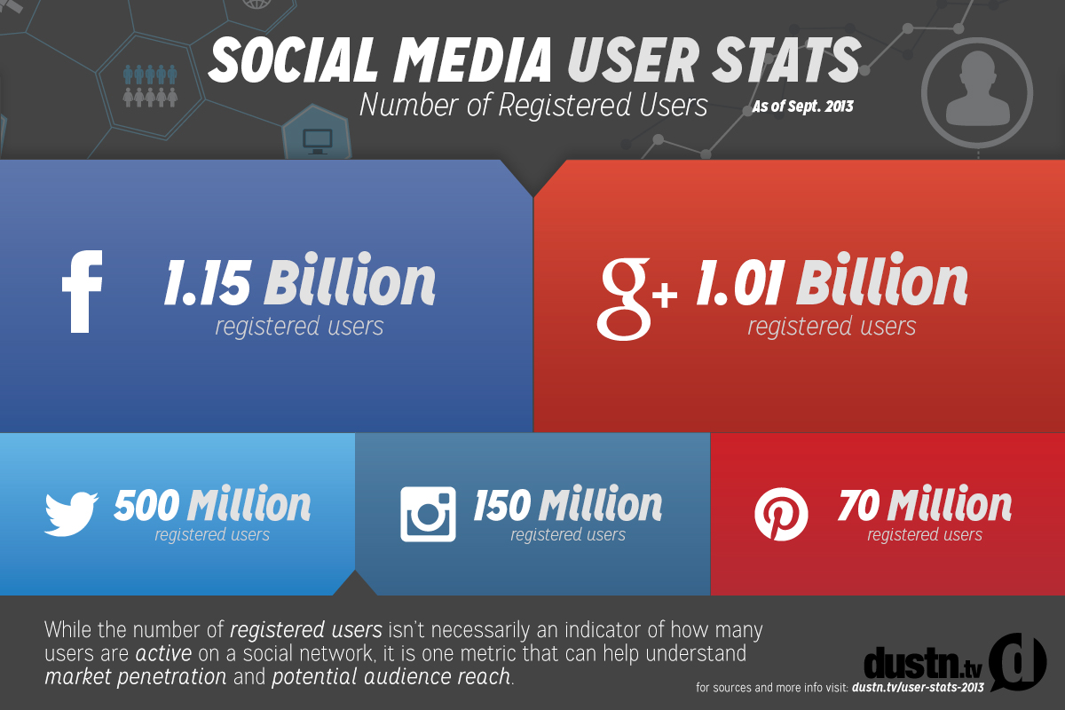
Social Media
Social Networks are increasing their number of users day by day.
This fact make social networks a good place for getting a better insight about people social habits.
@Vicente Rubén Del Pino Ruiz

Slide 3
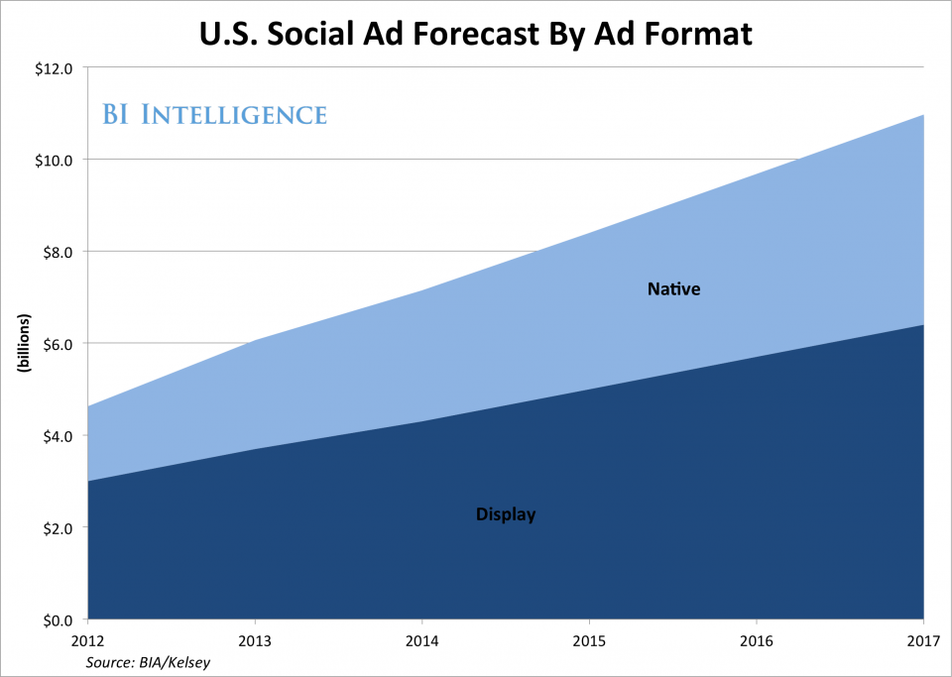
Advertising in Social Media
Reach specific groups of the population.
Get a better feedback of advertising.
@Vicente Rubén Del Pino Ruiz

Slide 4
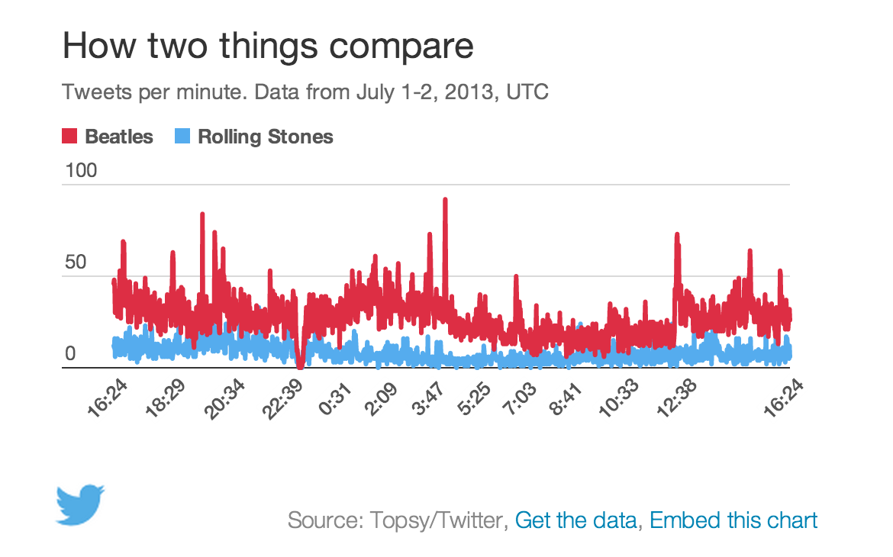
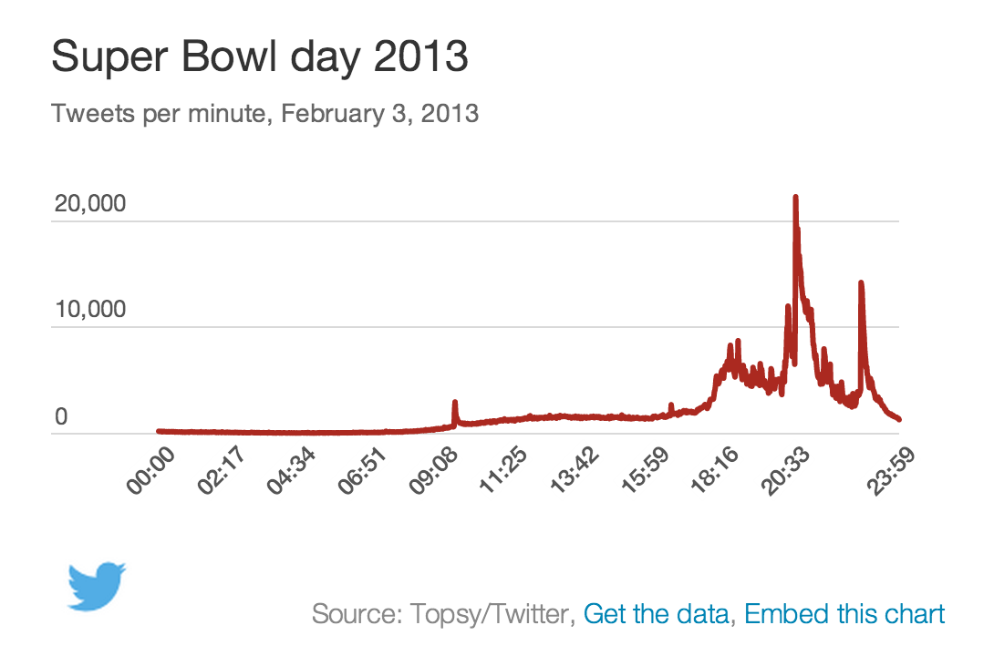
Measure engagement
How measure the engagement?
What is the data that can tell you how engaged your audience is on a Social Network?
  Mentions per minute
  Mentions per second
  Followers
  Sentiment
@Vicente Rubén Del Pino Ruiz

Slide 5
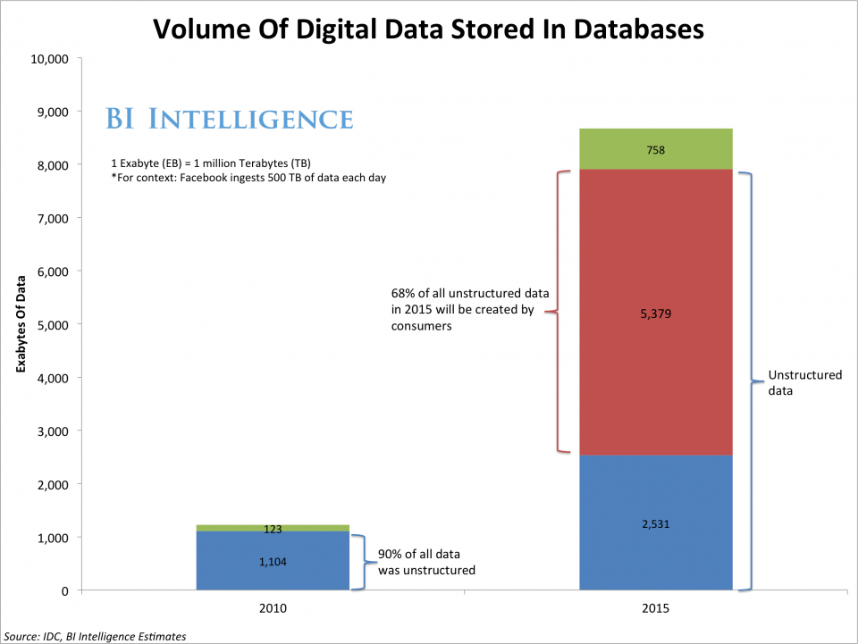
Data generated in Internet
Every second and endless stream of data is generated in Internet.
Social Networks record every aspect of our behavior in them: likes, friends, birthdays, relationships, trends…
@Vicente Rubén Del Pino Ruiz

Slide 6

Hadoop
Apache Hadoop is an open-source software framework for storage and large-scale processing of data-sets on cluster of commodity hardware.
More people is interested and using Hadoop everyday.
@Vicente Rubén Del Pino Ruiz

Slide 7
Hadoop (II)
With the use of Hadoop is possible to analyze data generated in Internet.
This data that seemed to be impossible to analyze, now is a feasible task using Hadoop.
@Vicente Rubén Del Pino Ruiz

Slide 8
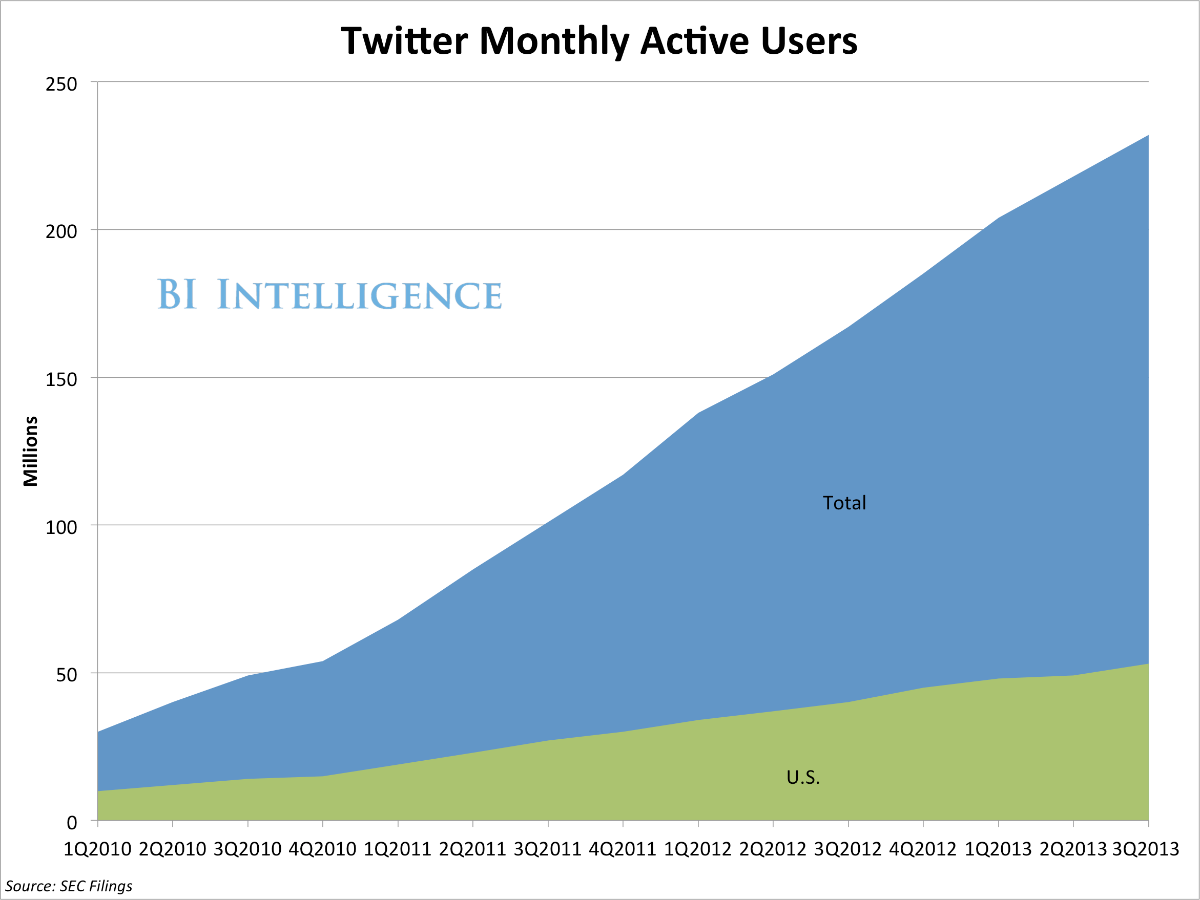
Twitter
Twitter is an online social networking and microblogging service that enables users to send and read short 140-character text messages, called “tweets”.
@Vicente Rubén Del Pino Ruiz

Slide 9
Movie Trender
The goal of this project is analyze in near real time information from Twitter.
This information will help me to see and compare relevance between search terms.
The movies searched for the demo are:
  The amazing Spider-Man 2
  The other woman
  Godzilla
  X-Men: Days of Future Past
  Transcendence
  Noah
  Maleficient
  Edge of tomorrow
  Blended
@Vicente Rubén Del Pino Ruiz

Slide 10
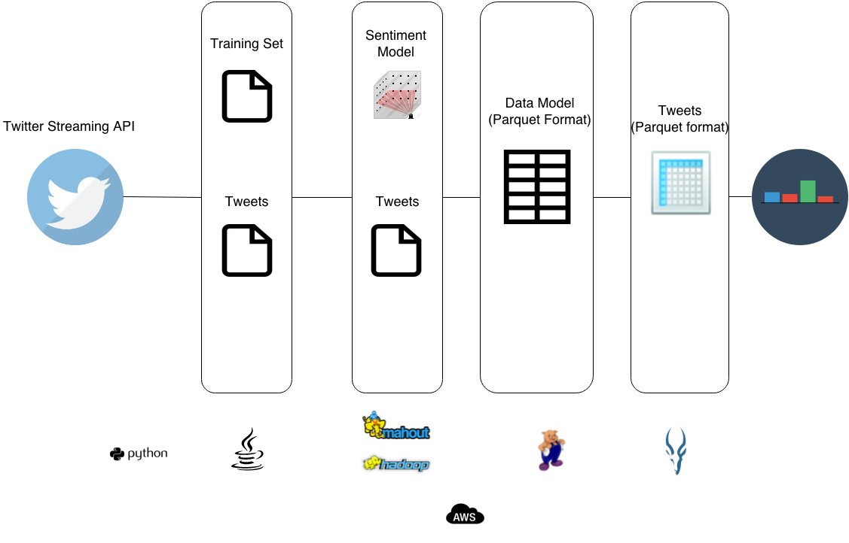
Movie Trender (II)
Design
@Vicente Rubén Del Pino Ruiz

Slide 11
Movie Trender (III)
Technologies Used:
  Java and Python.
  AWS
  Hadoop HDFS
  PIG
  Mahout
  Impala + Parquet
@Vicente Rubén Del Pino Ruiz

Slide 12

MT- AWS
Amazon Web Services is a collection of remote computing services that together make up a cloud computing platform.
Components used:
  Elastic MapReduce
  S3 (Simple Storage Service)
@Vicente Rubén Del Pino Ruiz

Slide 13

MT- PIG
Apache Pig is a platform for analyzing large data sets that consists of a high-level language for expressing data analysis programs.
Pig will be used in MovieTrender for moving data and storing them as a Parquet format.
@Vicente Rubén Del Pino Ruiz

Slide 14
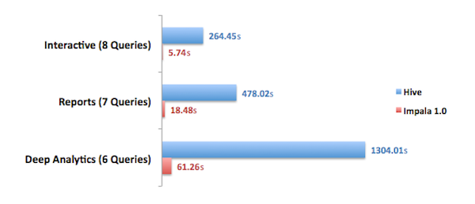
MT- Impala and Parquet
Impala has been created by Cloudera inspired on Google’s Dremel bringing real-time, ad hoc query capability to Apache Hadoop.
Parquet is built from the ground up with complex nested data structures in mind, and uses the repetition/definition level approach to encoding such data structures, as popularized by Google Dremel.
Cloudera benchmarks show Impala + Parquet 100x times faster than Hive.
@Vicente Rubén Del Pino Ruiz

Slide 15
MT- Analyze data in near real-time
Analyzing the data with Impala we can see the trends for any movie.
DEMO
@Vicente Rubén Del Pino Ruiz

Slide 16
Conclusions
Two big conclusions:
  Social Media has become an important source of data for analyzing behaviors and also a very important target for advertising.
  Using Hadoop we can analyze big volumes of data generated by Social Media.
@Vicente Rubén Del Pino Ruiz

